Slide 1
Comparing and Translating Computational Models
Evan Kozierok
evan.kozierok@pitt.edu
This project is supported by the Brackenridge Fellowship at the University of Pittsburgh Honors College.

Slide 2
Why Model?
Useful for researchers, businesspeople, and more
Leverage computational power
Simulation is low-risk, low-cost, and fast
Officials can use simulation results to guide policy
Which framework to choose?
Notes:
Models are used by scientific researchers, businesspeople, epidemiologists, and more to examine complex systems
Computers allow large models with many interactions to be simulated, and make it easy to experiment with parameters
Simulation allows you to explore risks, decisions, and outcomes using minimal resources
Government officials and company leaders can use simulations to prevent bad choices or implement new policies
However, it is not always obvious how various modeling frameworks differ, or which one to use for a specific scenario

Slide 3
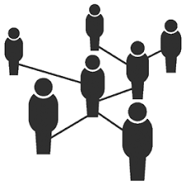
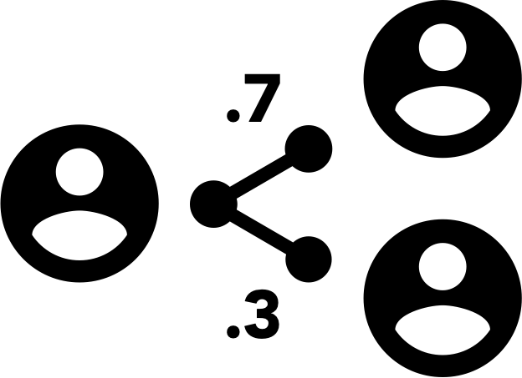
Key Modeling Frameworks
Agent-Based Models (ABMs)
Models individual agents interacting with each other and following a shared ruleset
Agents could be people, molecules, animals, etc.
Probabilistic Relational Agent-Based Models (PRAMs)
A new offshoot of ABMs that uses probabilistic averages rather than actual random sampling
Equivalent agents are grouped together
Notes:
ABM and PRAM are very similar: both have agents interacting with each other in a shared environment and with shared rules
The key distinction is that ABM works on an individual level, while PRAM works on a group level

Slide 4
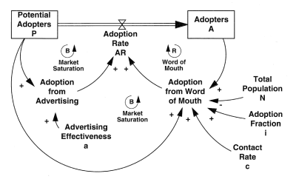
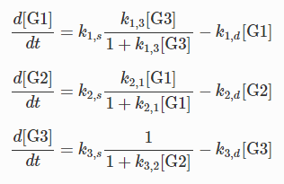
Key Modeling Frameworks
System Dynamics (SD) Models:
Measures various stocks and the flow between them
Common in economics and business
Abstract; uses mathematical formulas to determine flow
Ordinary Differential Equations (ODEs):
The system is described by rate of change equations
ODEs are often part of other models
Also abstract
Notes:
If ABMs are individual-level and PRAMs are group-level, SD and ODE models are population-level

Slide 5
Purpose and Significance
This project has two main components:
The Python software package pram2mesa, for translating a PRAM (written using PyPRAM) into an equivalent ABM (written using Mesa)
Theoretical and practical comparisons between modeling frameworks, especially between PRAM and ABM
This allows modelers to:
Better understand the strengths of each framework
Comprehend a PRAM model, even if unfamiliar with how PRAM works
Use analysis tools designed for ABMs on a PRAM

Slide 6
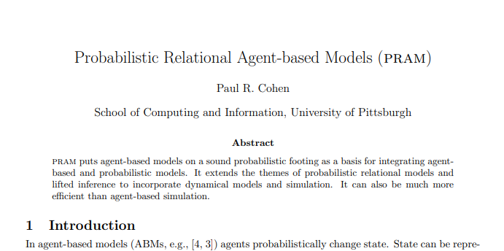
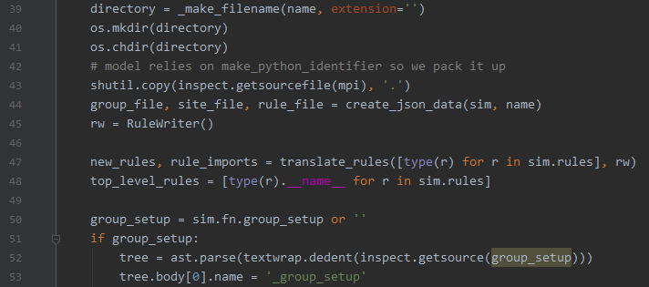
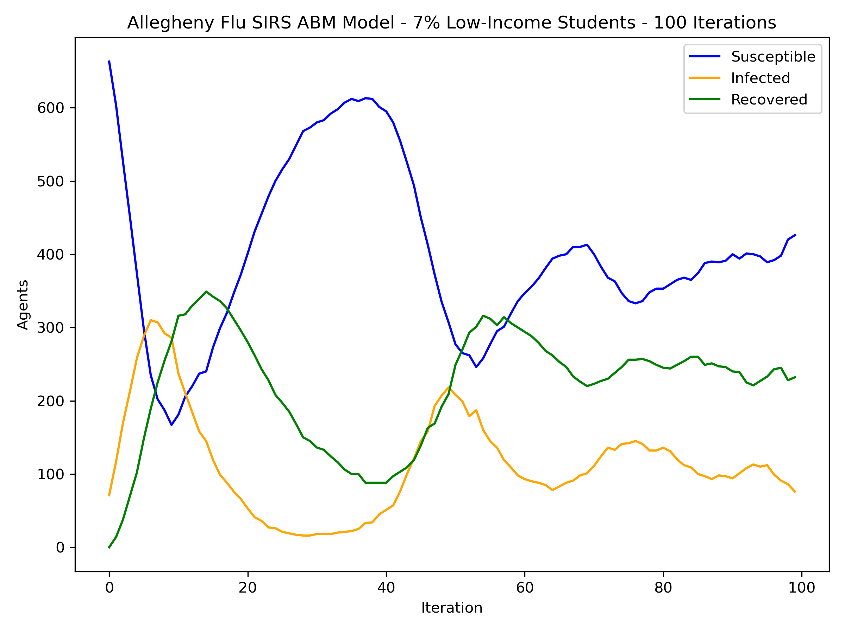
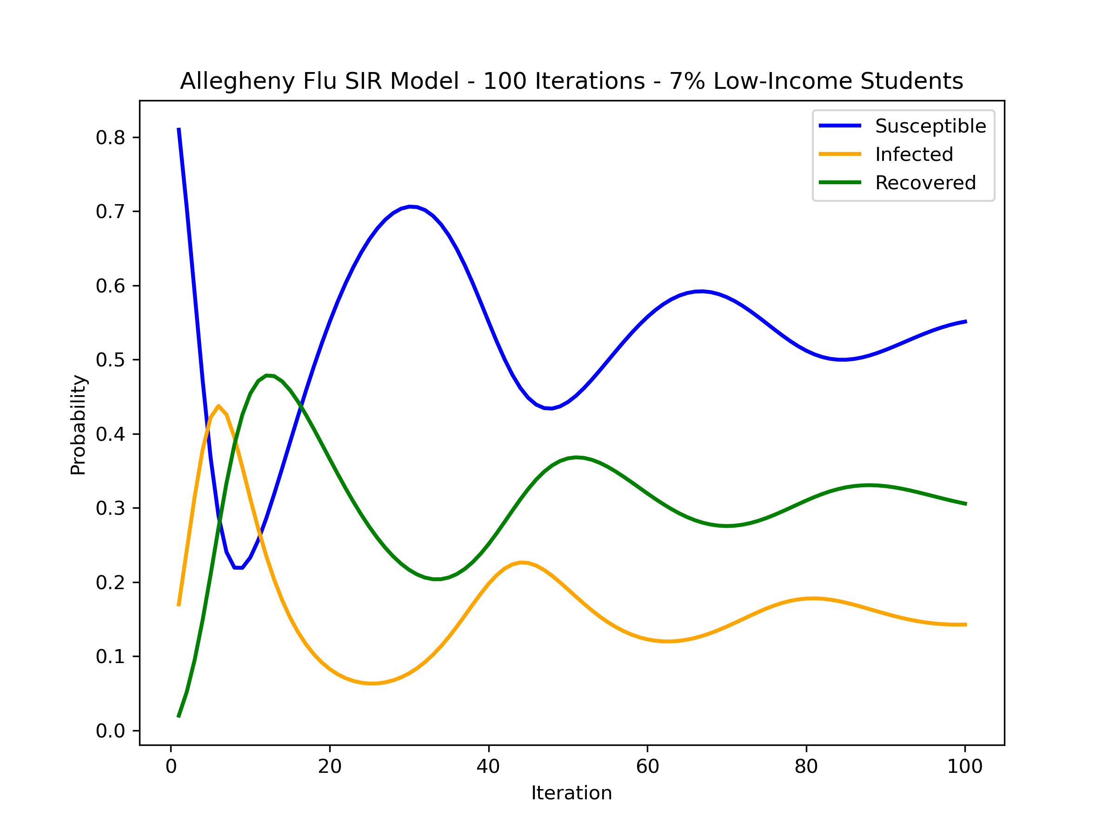
Summer Overview
Weeks 1-2:
In depth investigation/reading modeling research and literature
Weeks 3-4:
Familiarizing myself with Python tools used to make models (i.e. PyPRAM and Mesa)
Creating sample models
Weeks 5-9:
Coding and testing pram2mesa
Weeks 10+:
Finishing touches on pram2mesa
Using pram2mesa and analyzing results

Slide 7
Project Scope
The original plan for this summer’s research included multiple translations tools, including tools for converting ABM → PRAM and PRAM ↔ SD models.
These plans were scrapped for the following reasons:
Time
Quality
Complexity
Developing pram2mesa took longer than expected
Important to ensure pram2mesa was high quality
ABMs are more complex and open-ended
Compatibility
SD modeling is not commonly done in Python
Notes:
Spending additional time polishing pram2mesa was preferable to creating multiple, worse pieces of software
ABMs are more open-ended and flexible than PRAMs, making it difficult to create a PRAM from an ABM

Slide 8
pram2mesa

Slide 9

What is pram2mesa?
Original PRAM
Name for new ABM
The pram2mesa software package converts PRAMs into equivalent ABMs.
PyPRAM: the original Python implementation of PRAM
Mesa: a popular Python library for writing ABMs
Hence the name, pram2mesa.
The code and examples can be found on the project’s GitHub repository:
https://github.com/evankozierok/pram2mesa
>>> pram2mesa(my_PRAM, 'my_new_ABM')
my_new_ABMModel.py
my_new_ABMAgent.py
my_new_ABMGroups.json
my_new_ABMSites.json
my_new_ABMRules.json
make_python_identifier.py
generates
Python files to run the ABM
Additional data on agents, locations, and rules
Additional behind-the-scenes functions

Slide 10
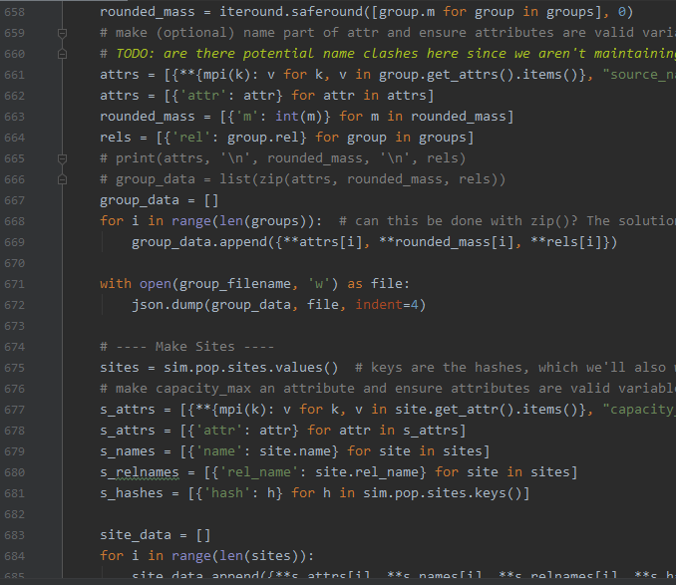
How does it work?
The beauty of software is that users don’t need to know exact implementation details!
However, briefly, pram2mesa:
Stores info about a PRAM’s agents and locations in JSON data files
Translates PyPRAM code into code that does the same thing in Mesa
Fills in a template for the new Mesa Python files with model-specific rules and functions
For details, feel free to explore the code yourself, or contact me.

Slide 11



Room for Improvement
Like most software, pram2mesa is never truly finished, and there is much that can be improved:
Models generated by pram2mesa are very slow
In general, ABMs are slower than PRAMs, but pram2mesa is slow even for an ABM
Some functionality of PRAMs is not yet supported
There will always be bugs to fix!
Notes:
Not supported: some types of rules
Bug fixing also includes reliability and testing

Slide 12
Comparing PRAMs and ABMs

Slide 13
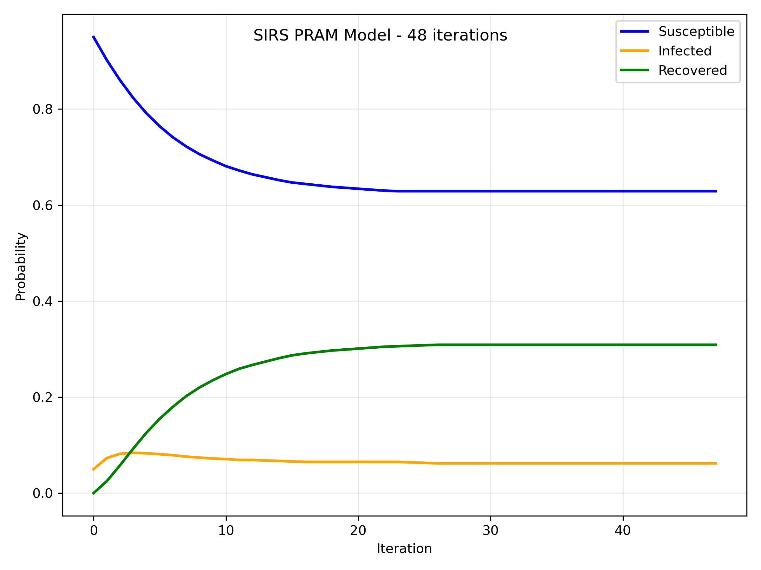
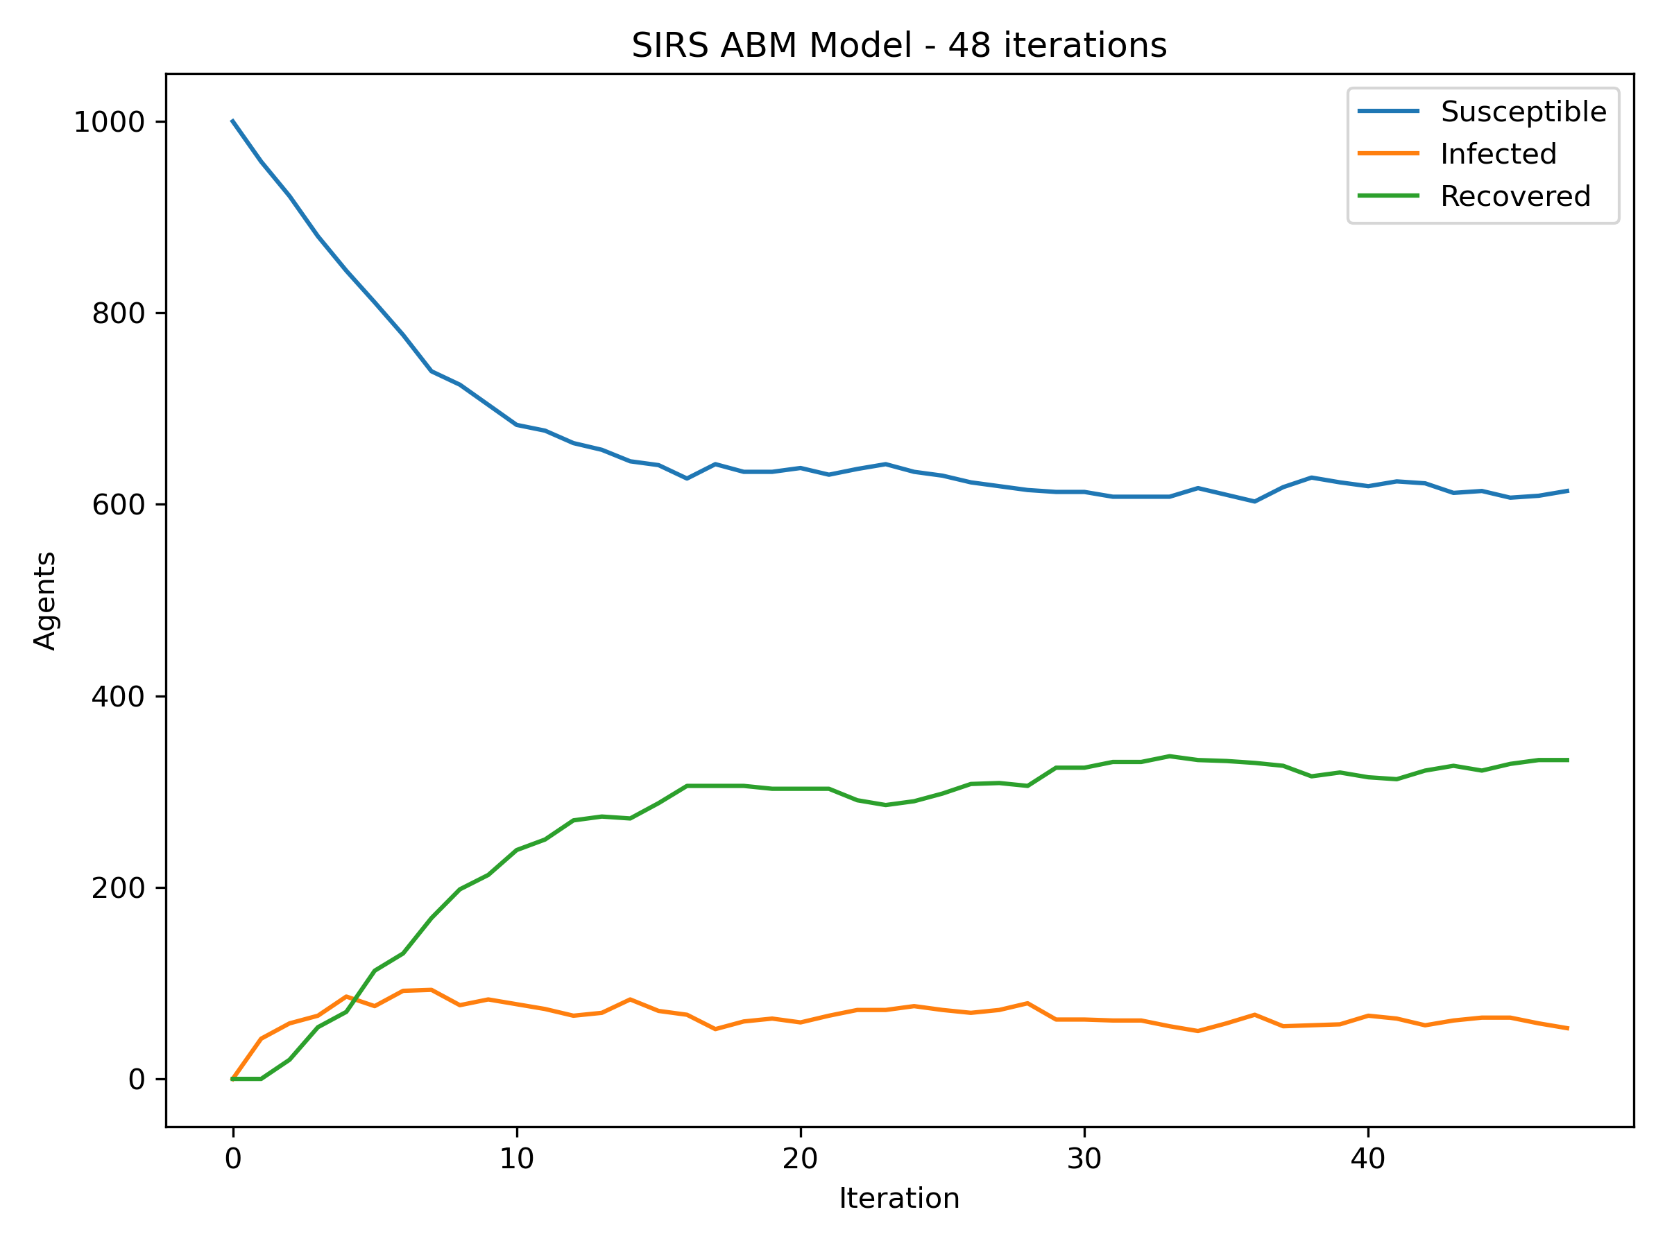
SIRS Model
An SIRS Model simulates the spread of an infectious disease. Agents (people) may be Susceptible to contracting it, Infected with it, or have Recovered from it. Recovered agents may lose their immunity and become Susceptible again.
SIRS Model in PRAM
Translated SIRS ABM
Notes:
Note how the PRAM model produces smooth lines – this is because it averages the number of agents being infected, recovered, or susceptible
I.e: if 1000 agents are Susceptible with a 0.1 chance to become infected:
PRAM: 100 agents will move from Susceptible to Infected
ABM: Checks each agent individually. On average, 100 will be infected, but the empirical number varies

Slide 14
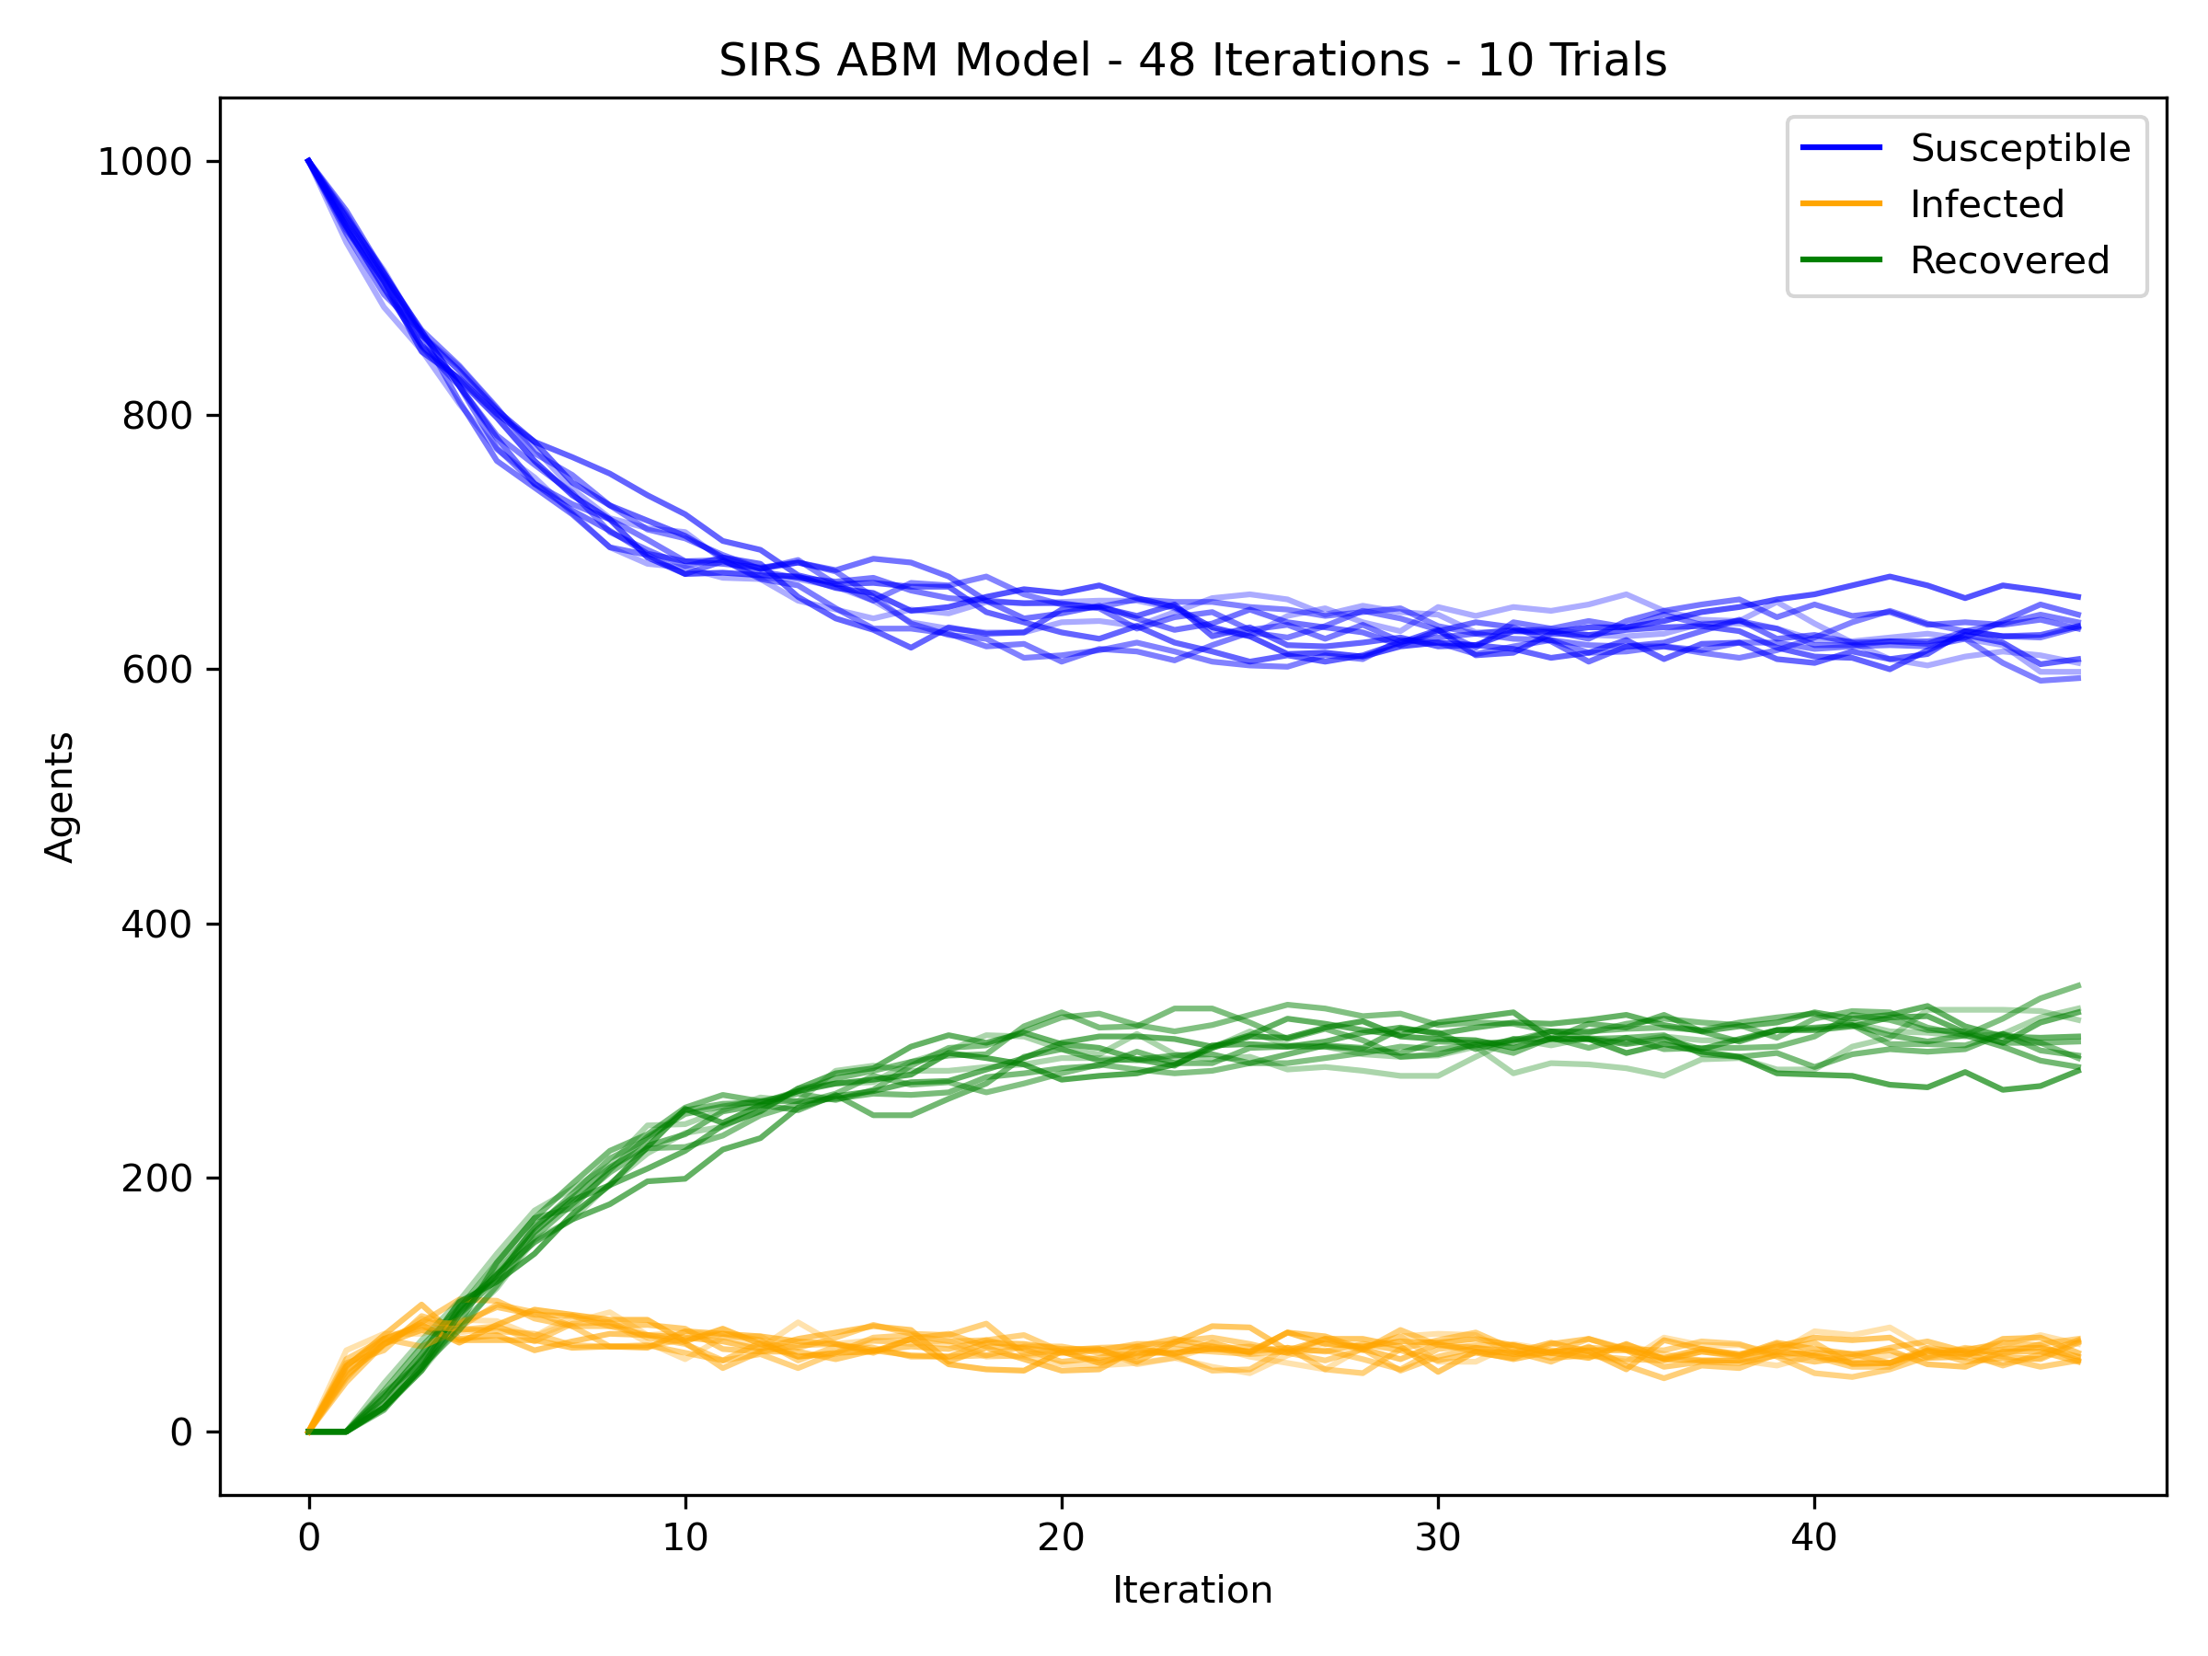
SIRS Model
An SIRS Model simulates the spread of an infectious disease. Agents (people) may be Susceptible to contracting it, Infected with it, or have Recovered from it. Recovered agents may lose their immunity and become Susceptible again.
SIRS Model in PRAM
Translated SIRS ABM
(10 Trials)
Notes:
Models with stochasticity (randomness) are often run several times to avoid outliers and get a better grasp of shape/dynamics
The PRAM doesn’t need this, because there is not actually randomness

Slide 15
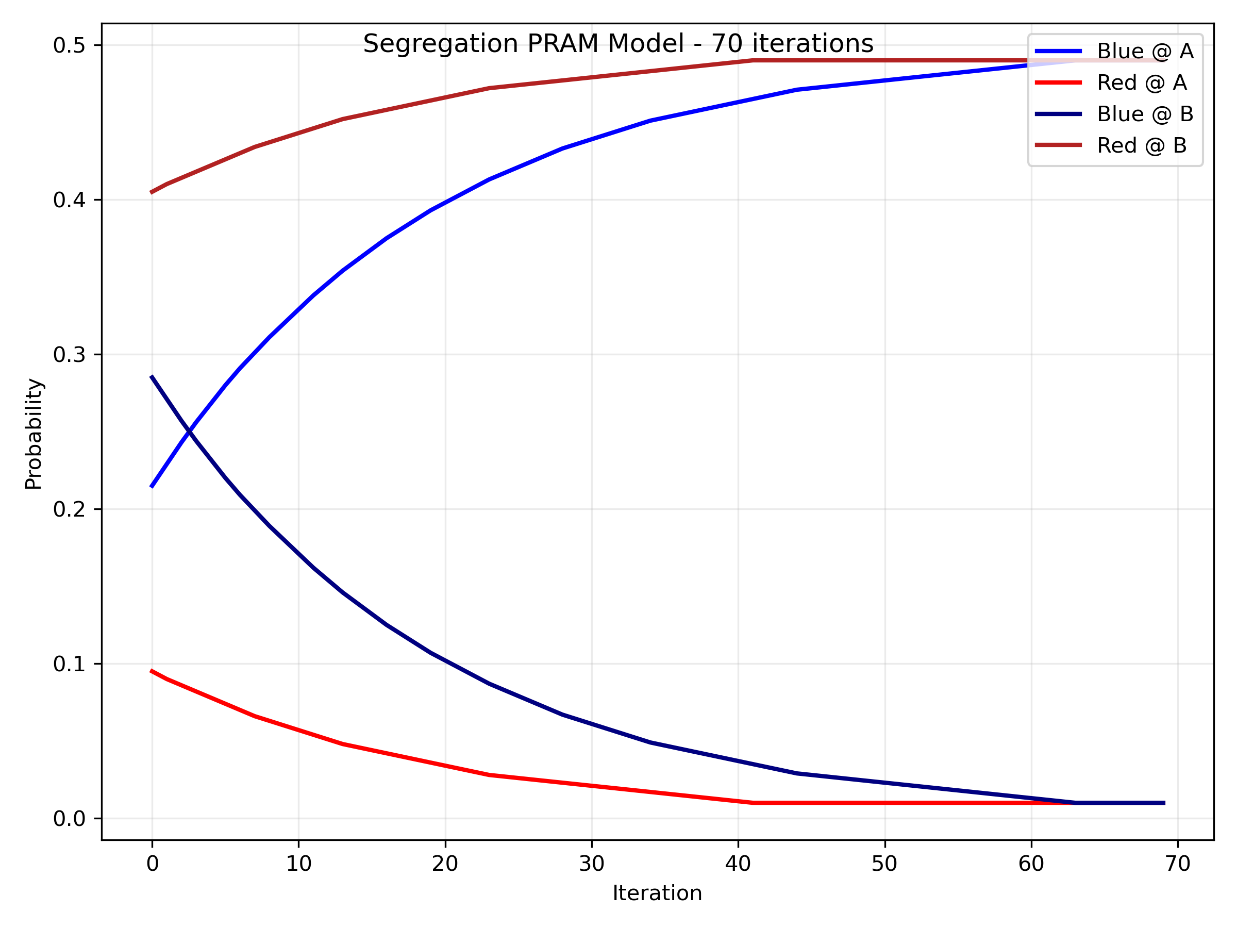
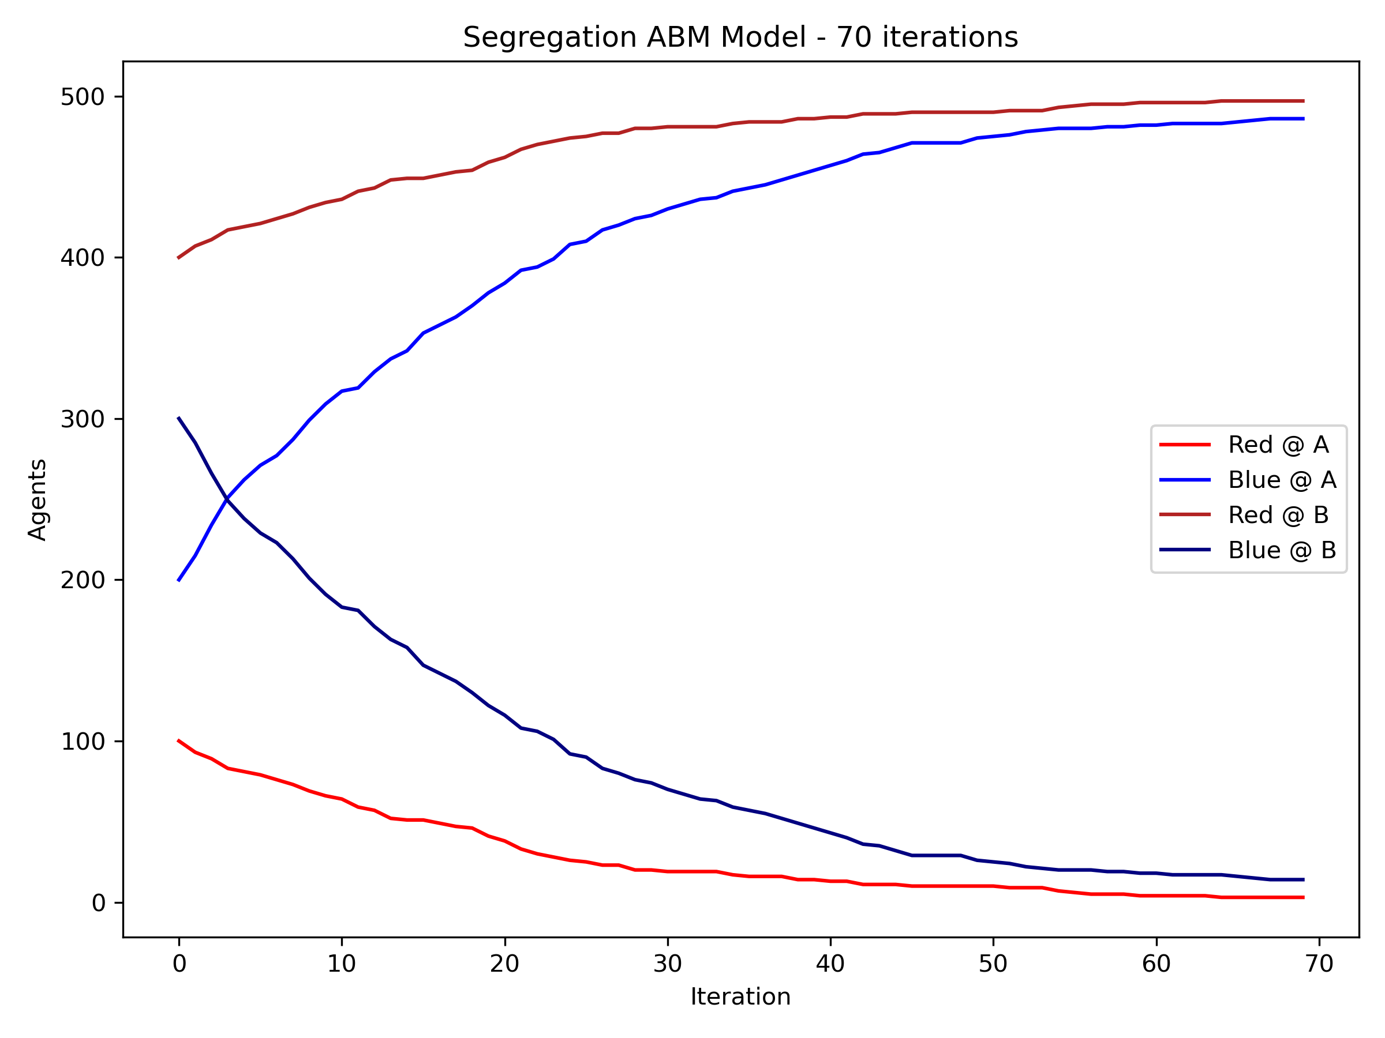
Segregation Model
In this segregation model, agents are red or blue and reside at one of two sites (A or B). If an agent’s color is the minority color at a site, agents of that color may migrate to the other site, leading to segregation.
SIRS Model in PRAM
Translated SIRS ABM

Slide 16
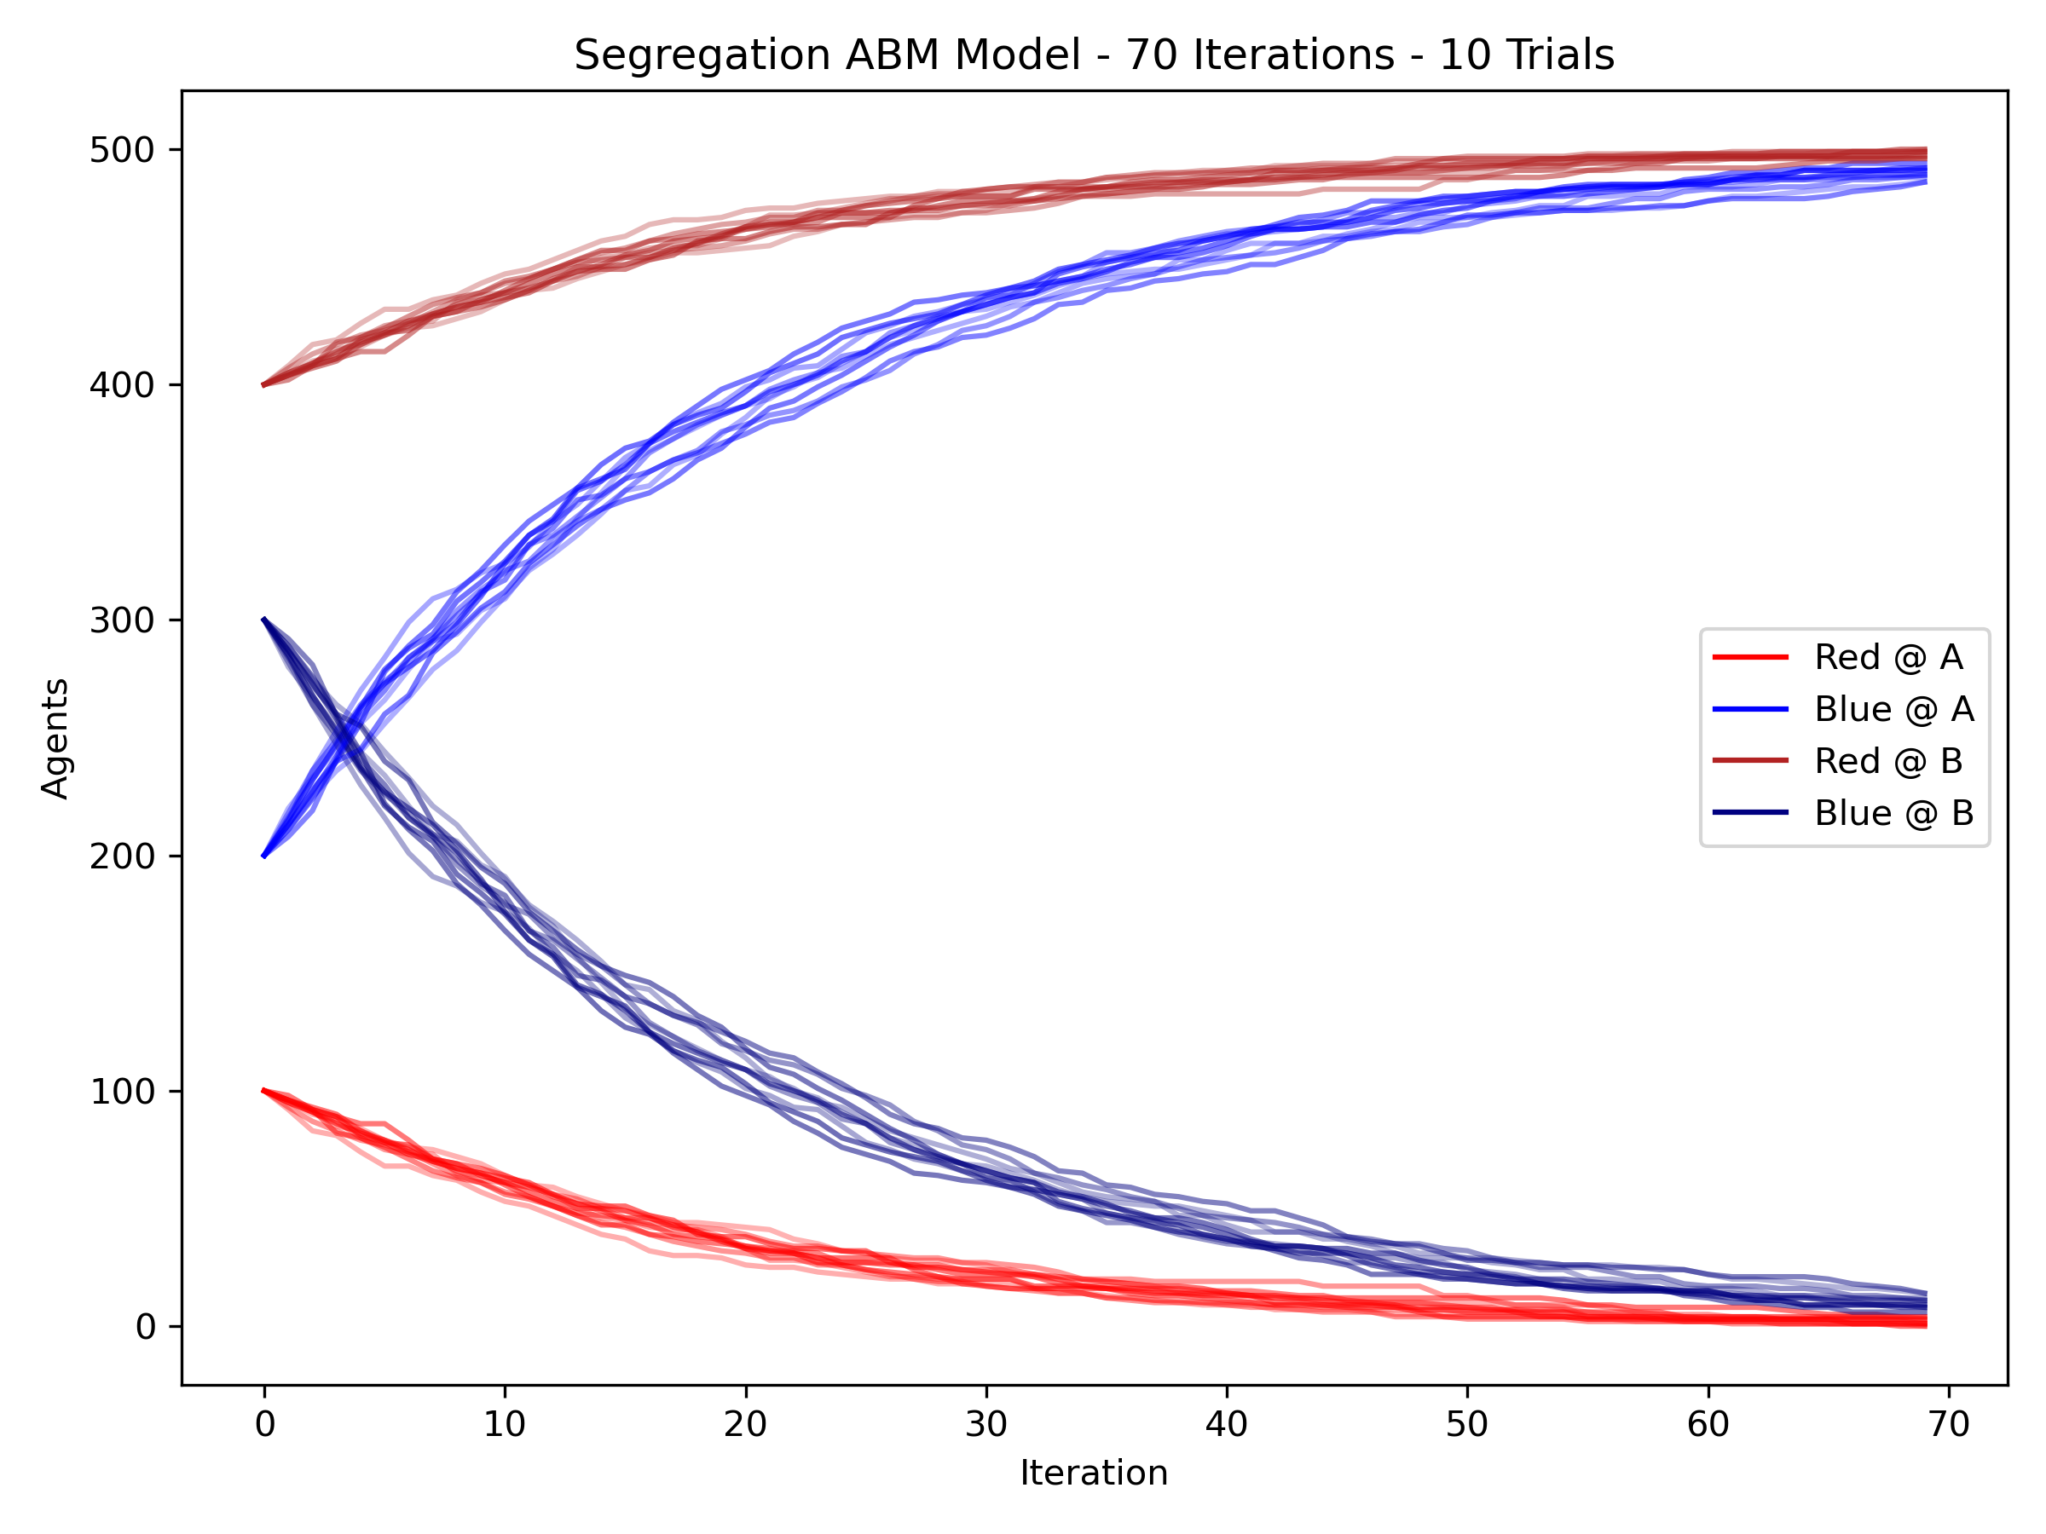
Segregation Model
In this segregation model, agents are red or blue and reside at one of two sites (A or B). If an agent’s color is the minority color at a site, agents of that color may migrate to the other site, leading to segregation.
Segregation Model in PRAM
Translated Segregation ABM
(10 Trials)

Slide 17
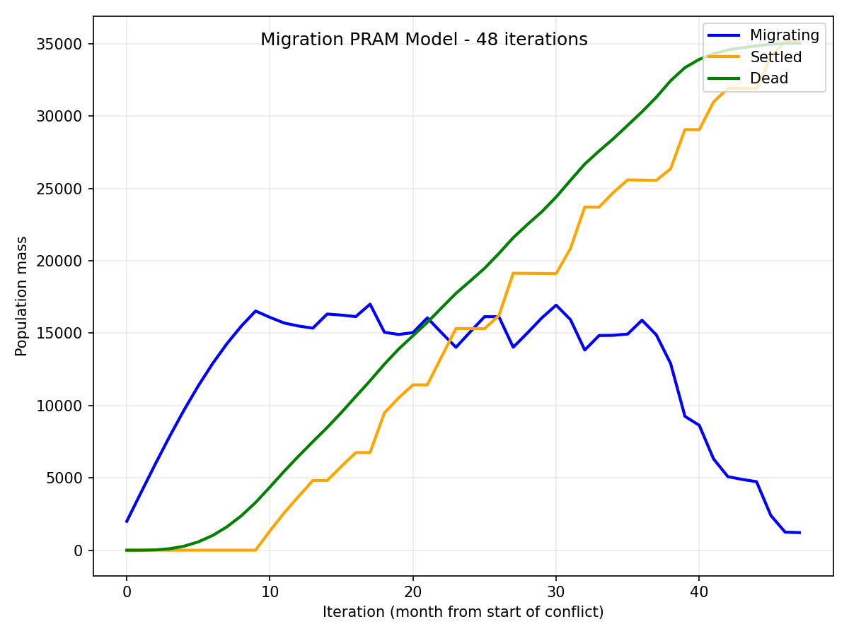
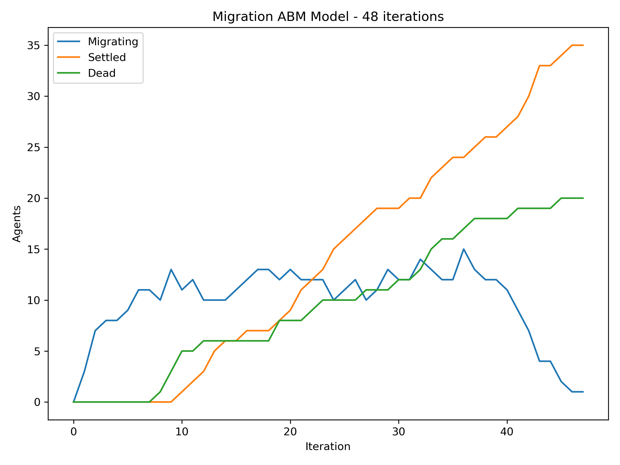
Migration Model
In this model, agents start at the site of a 3-year conflict. Agents there may die or migrate to another country. Each country requires a different amount of travel time, and agents may die on the journey. If they arrive, they settle there.
Migration Model in PRAM
Translated Migration ABM
Notes:
The shape of the migration curve:
Goes up while agents flee the conflict and haven’t started settling yet
Stays stable while agents are both fleeing and settling at equal rates
Goes down when the conflict ends no new migration starts
Caveat: ABM has population size 1,000, while PRAM has size 1,000,000 (more on next slide)

Slide 18
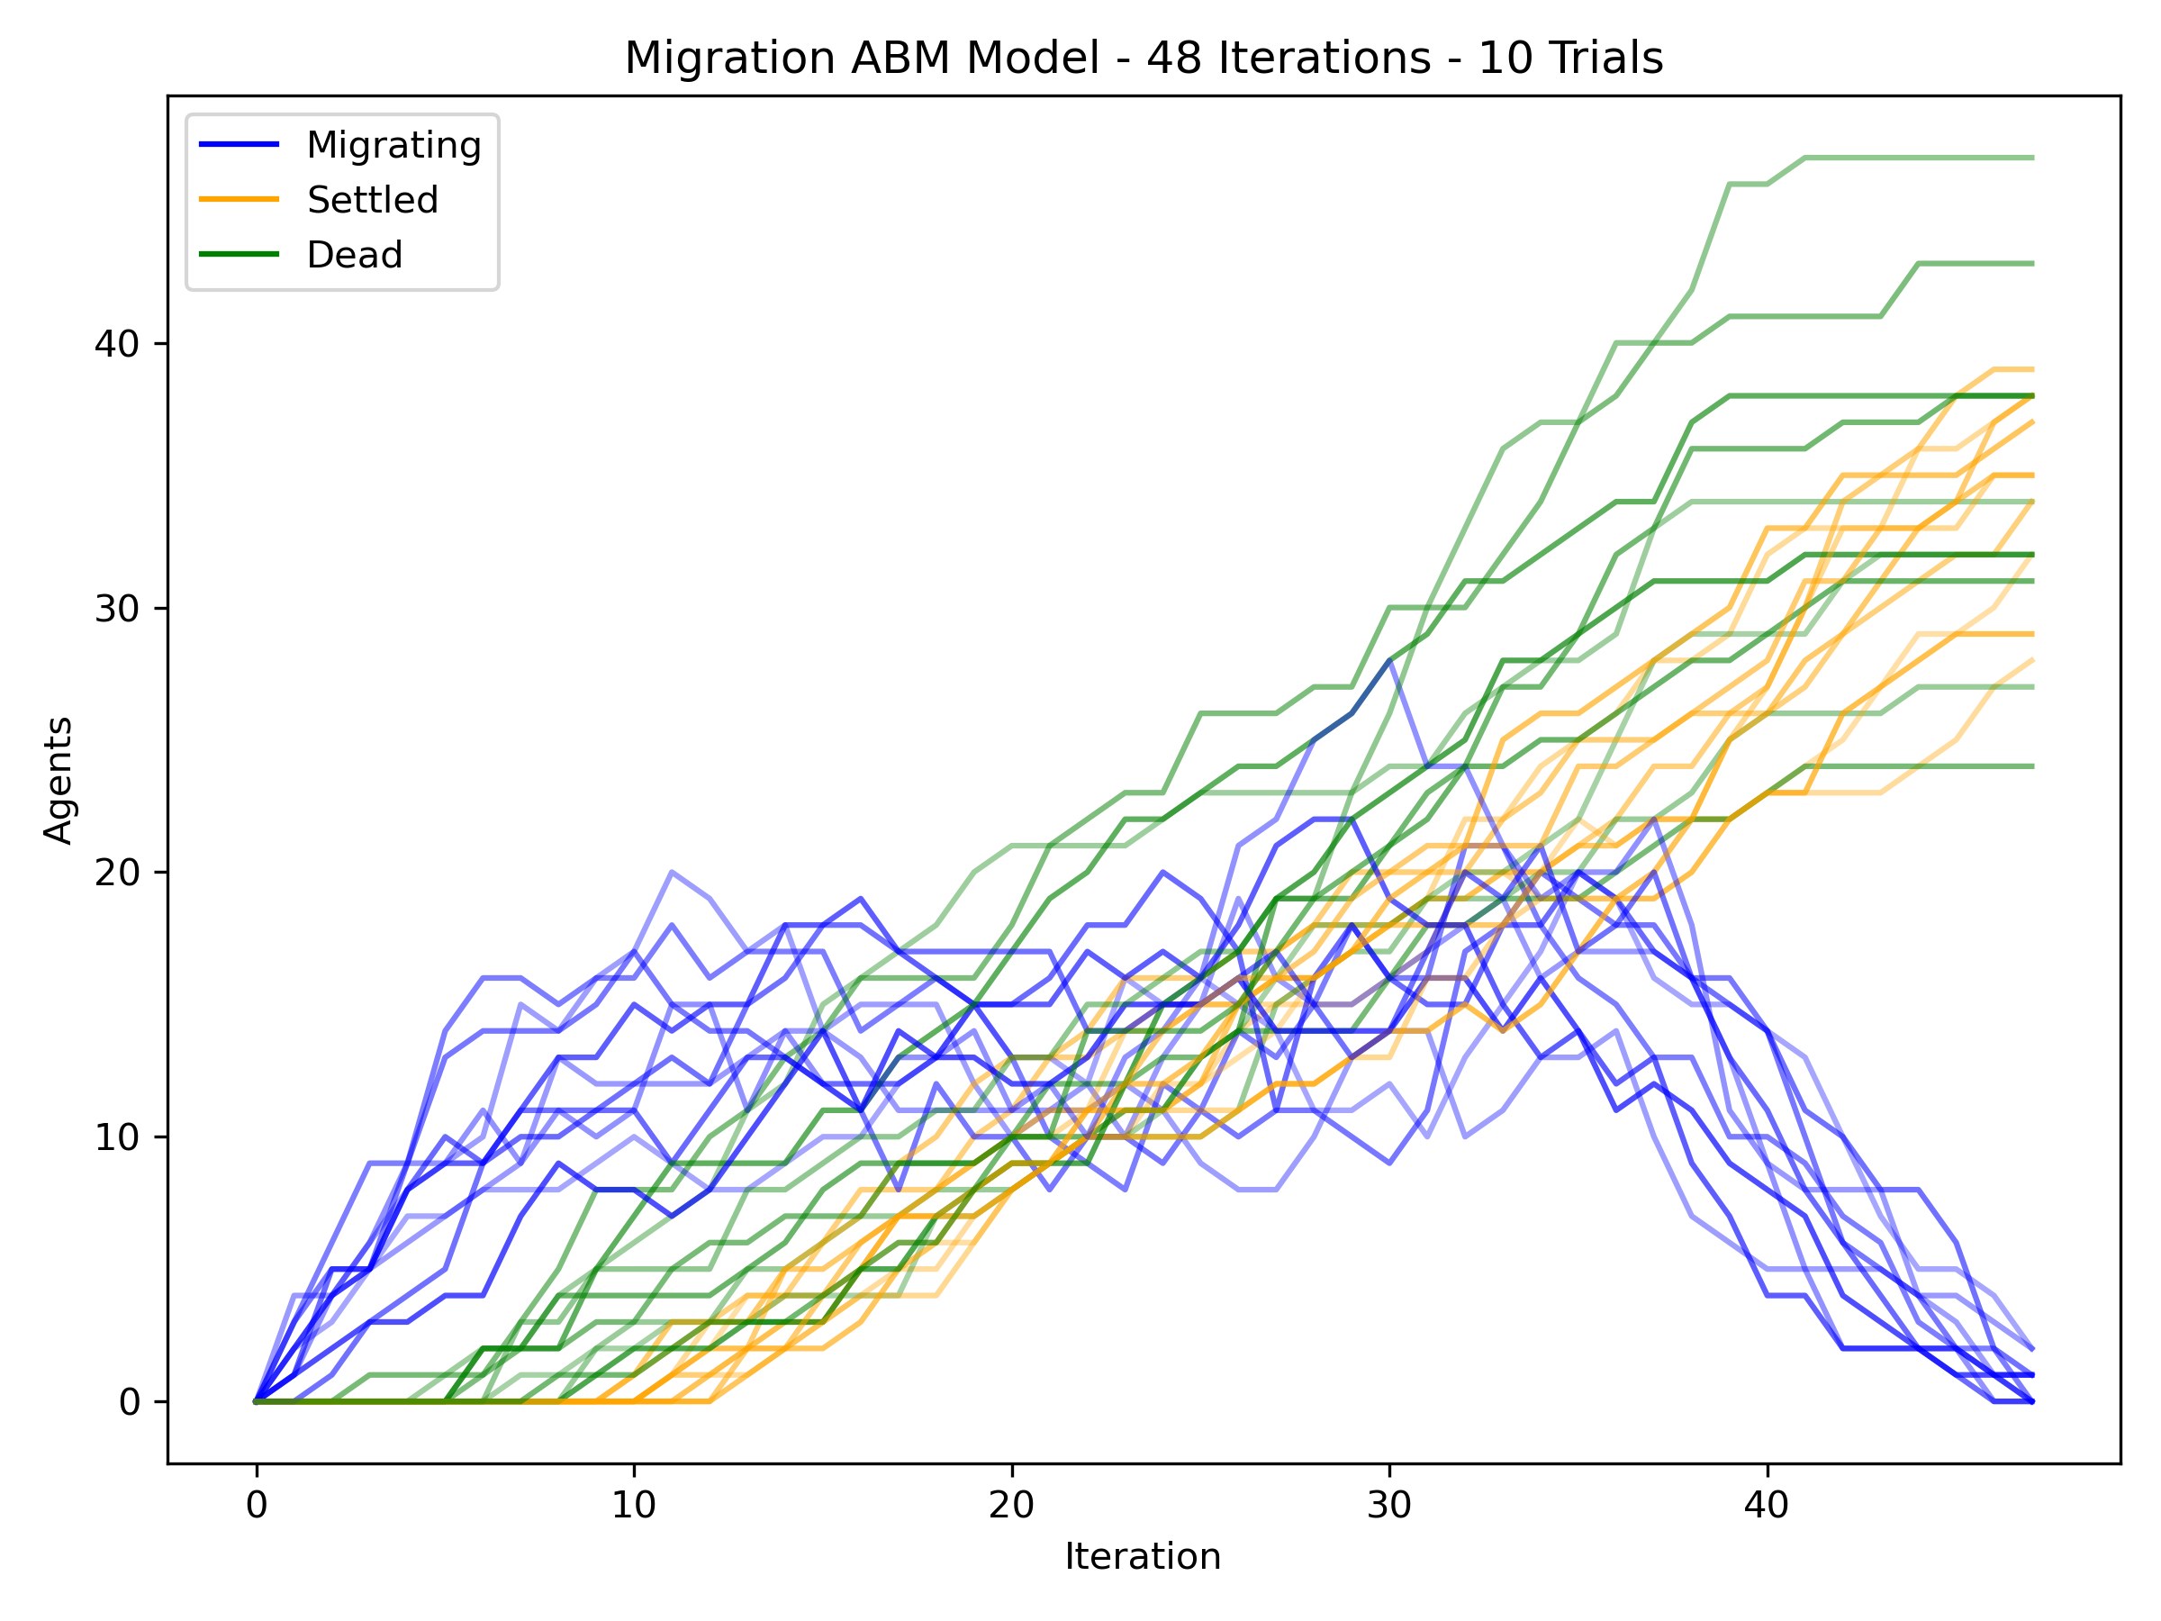
Migration Model
In this model, agents start at the site of a 3-year conflict. Agents there may die or migrate to another country. Each country requires a different amount of travel time, and agents may die on the journey. If they arrive, they settle there.
Migration Model in PRAM
Translated Migration ABM
(10 Trials)
Notes:
Caveat: ABM has population size 1,000, while PRAM has size 1,000,000 (more on next slide)

Slide 19
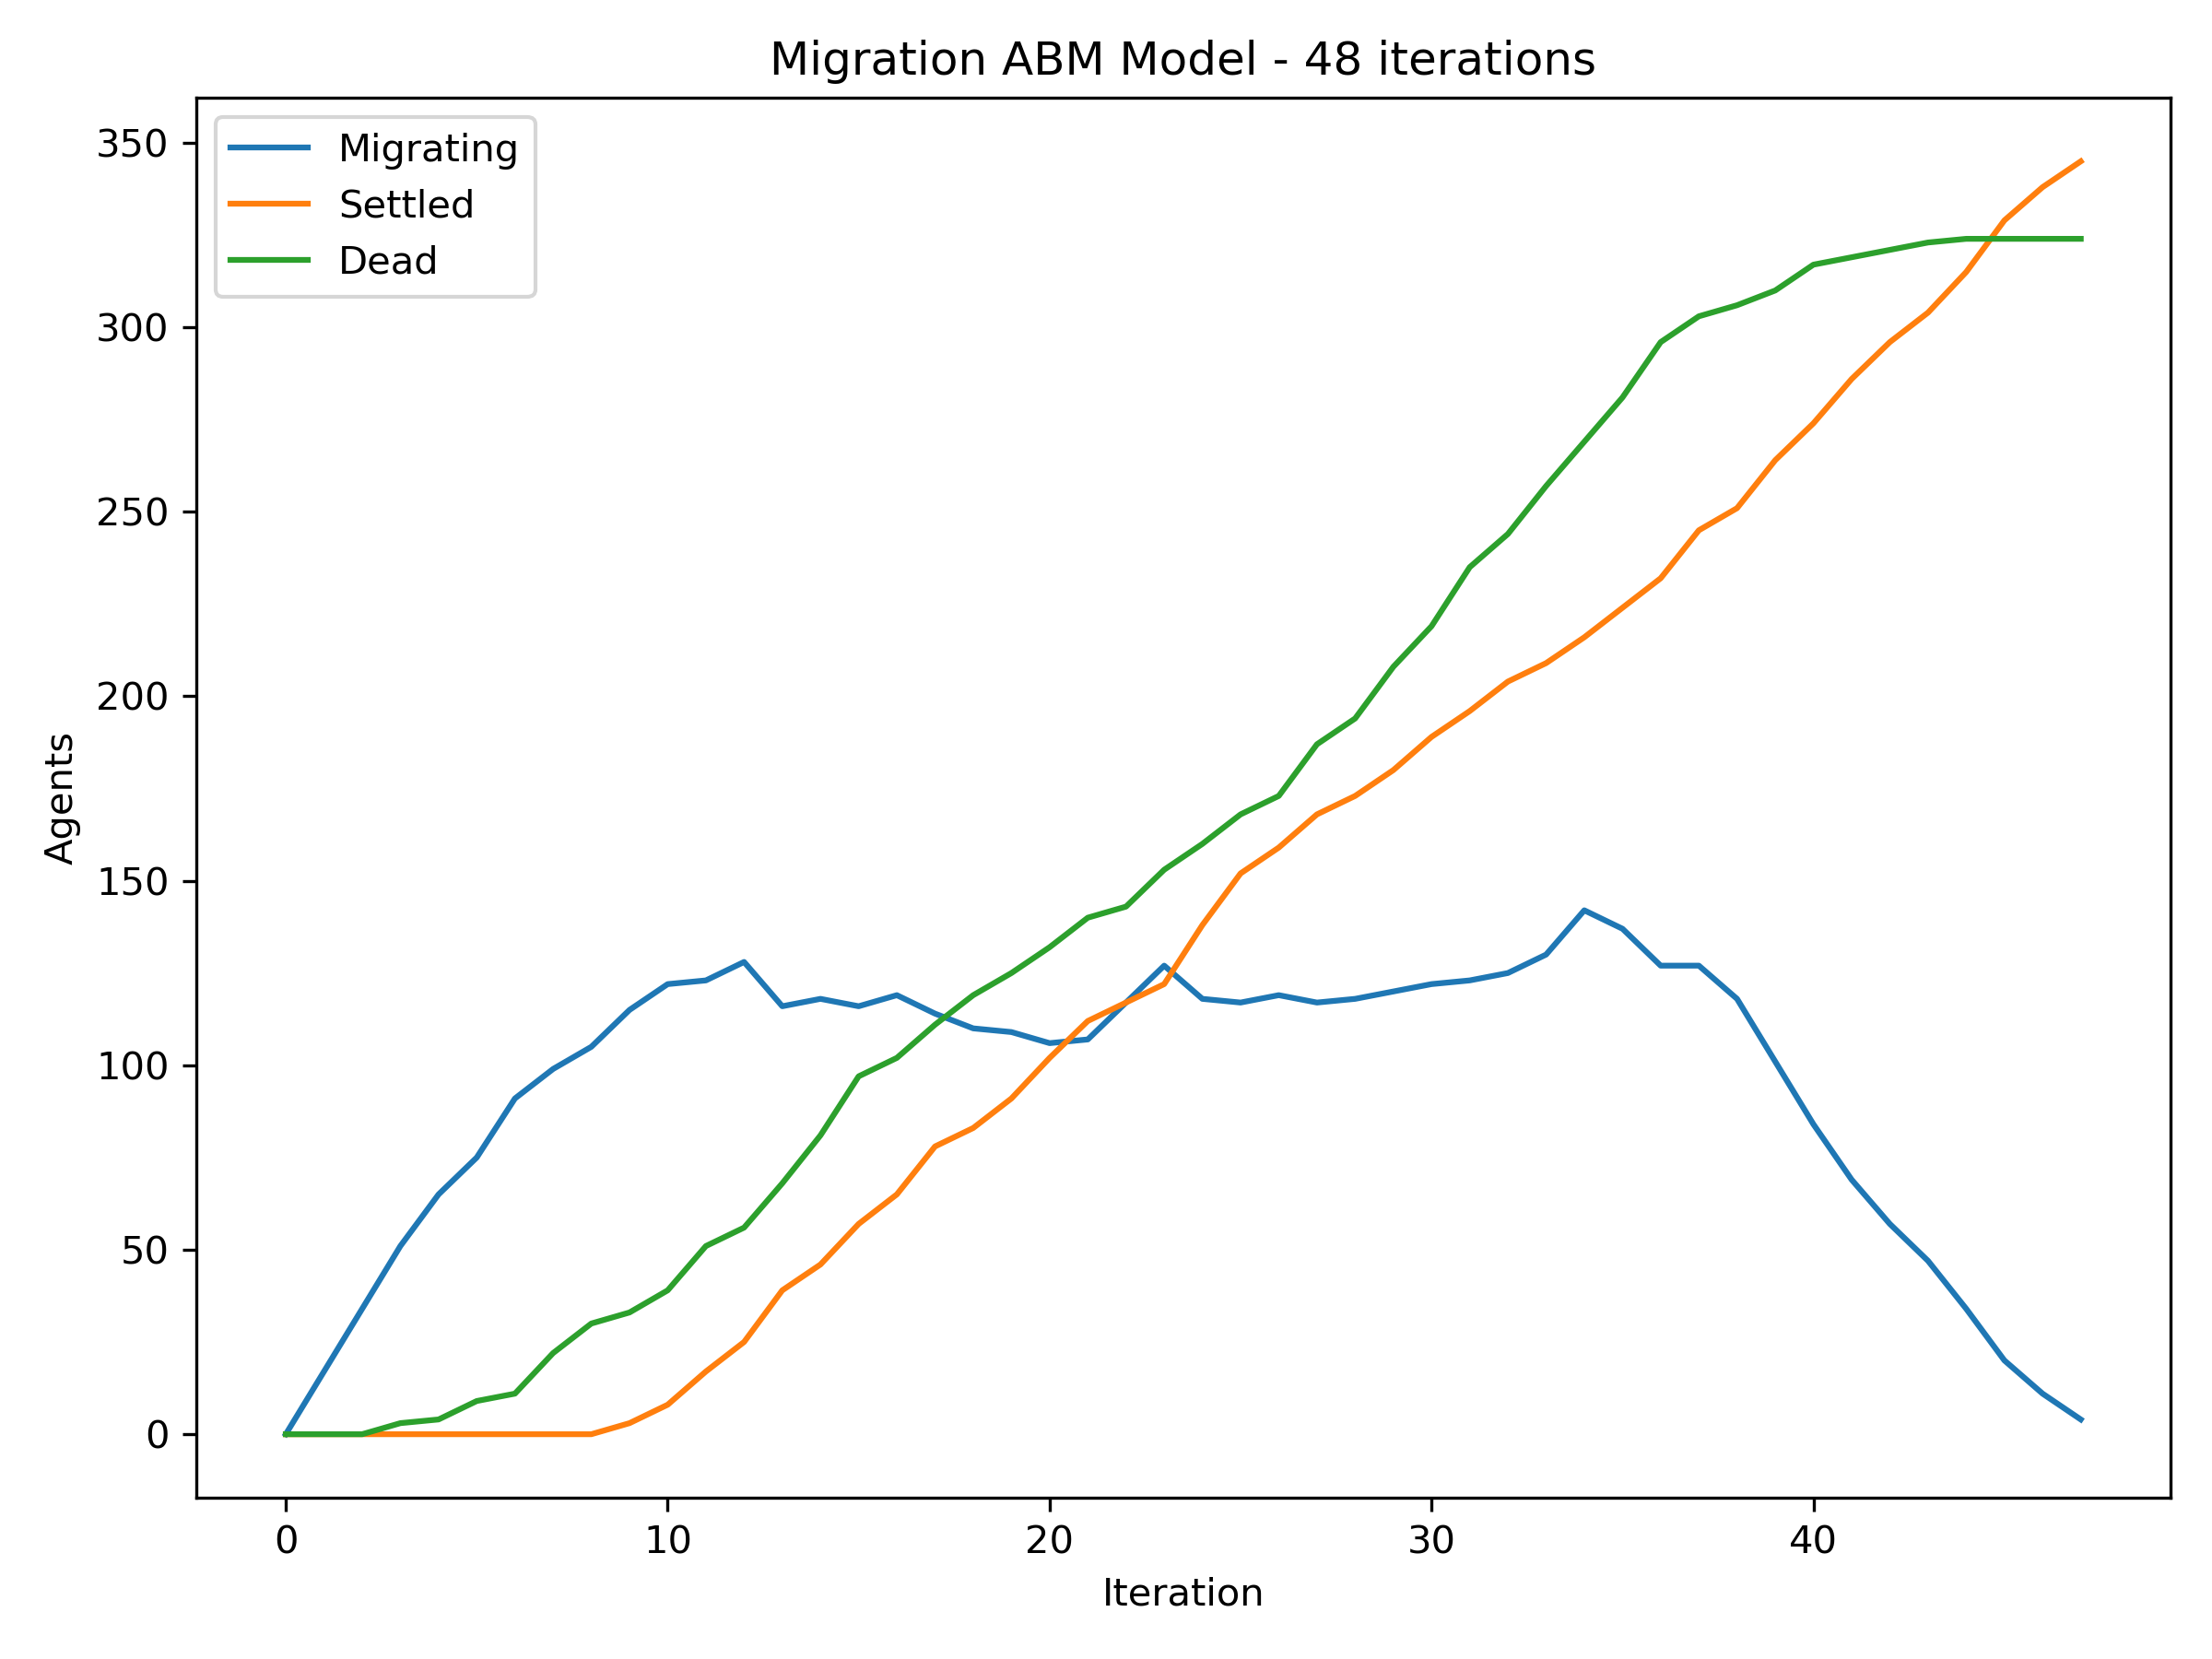
What’s different here?
The PRAM simulates 1,000,000 agents, while the ABM has been reduced to 1,000 for time concerns
If we up the ABM’s size to 10,000…
It becomes much smoother!
Translated Migration ABM
(10,000 Agents)
Notes:
(The 1,000,000 agent ABM might take weeks!)

Slide 20
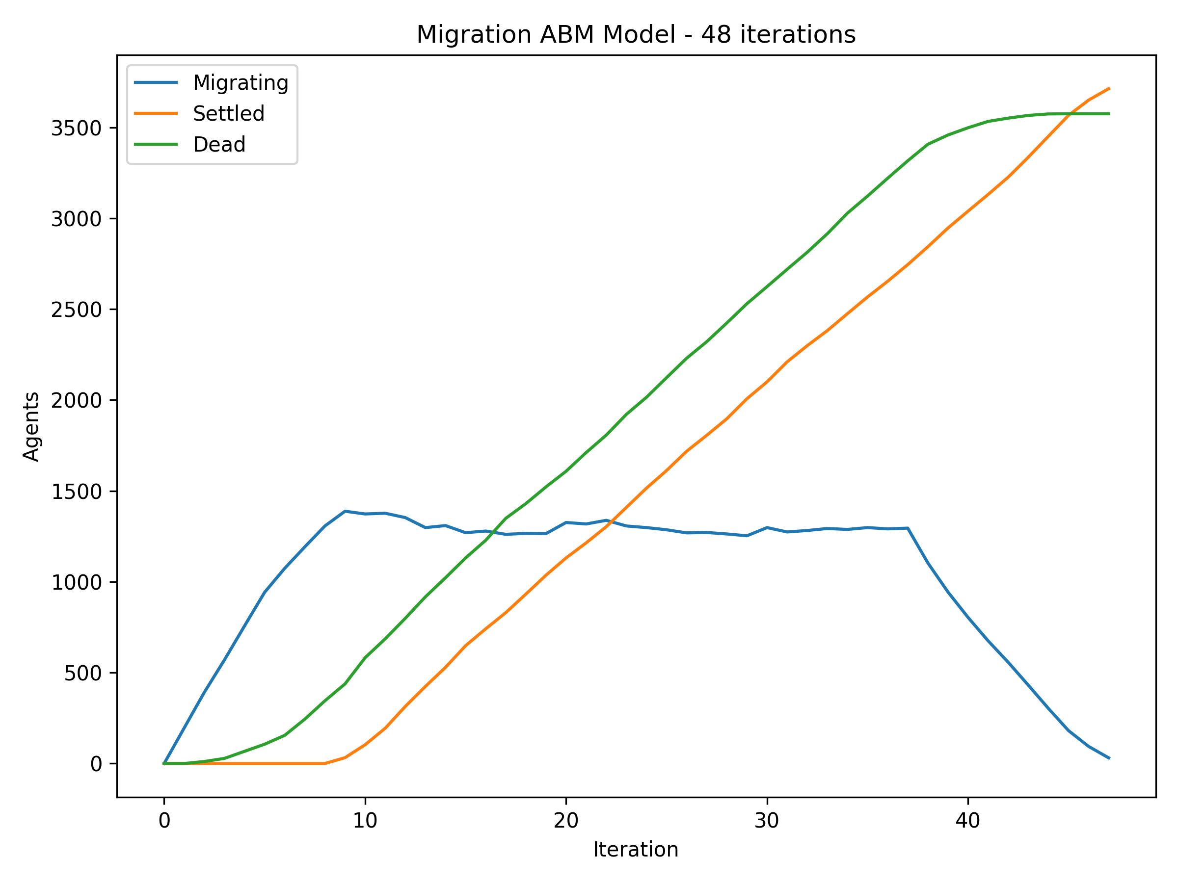
What’s different here?
The PRAM simulates 1,000,000 agents, while the ABM has been reduced to 1,000 for time concerns
If we go to 100,000…
It is smoother than the PRAM!
Translated Migration ABM
(100,000 Agents)

Slide 21






What’s different here?
⋮
(10,000 dice)
⋮
(1,000 groups
of 10 dice)
This PRAM randomly (not probabilistically) chooses destinations for large groups
This leads to chunks of agents migrating and settling
The ABM chooses a destination for each individual agent
Think of the dice as migration locations
Notes:
The PRAM chooses the destination for a group of hundreds/thousands of agents as the same place.
This could be avoided: the PRAM could deterministically split groups destinations equally or using some other method
Is this a problem? No, just a different model
Maybe people migrate in caravans, so the chunking is appropriate

Slide 22
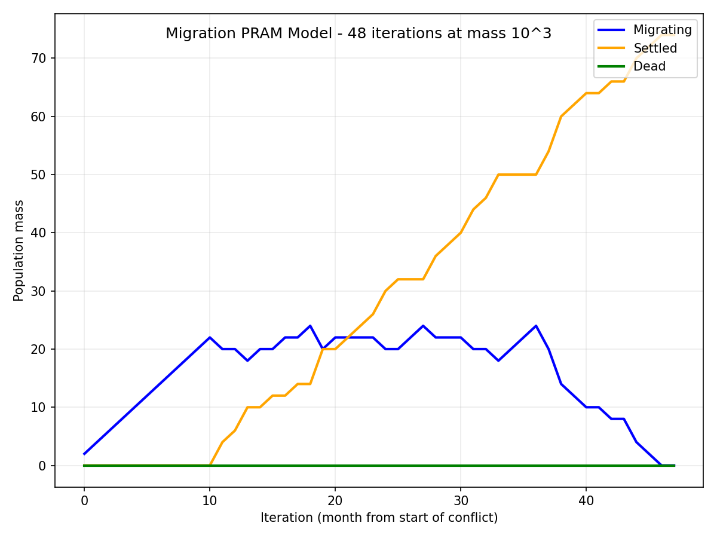
What’s different here?
The probability of death is low, so smaller sample sizes can lead to variance from sheer randomness
In fact, the PRAM struggles with smaller population sizes
At 1,000 agents, the expected deaths of agents gets unrealistically rounded off to 0
Migration Model in PRAM
(1,000 Agents)

Slide 23
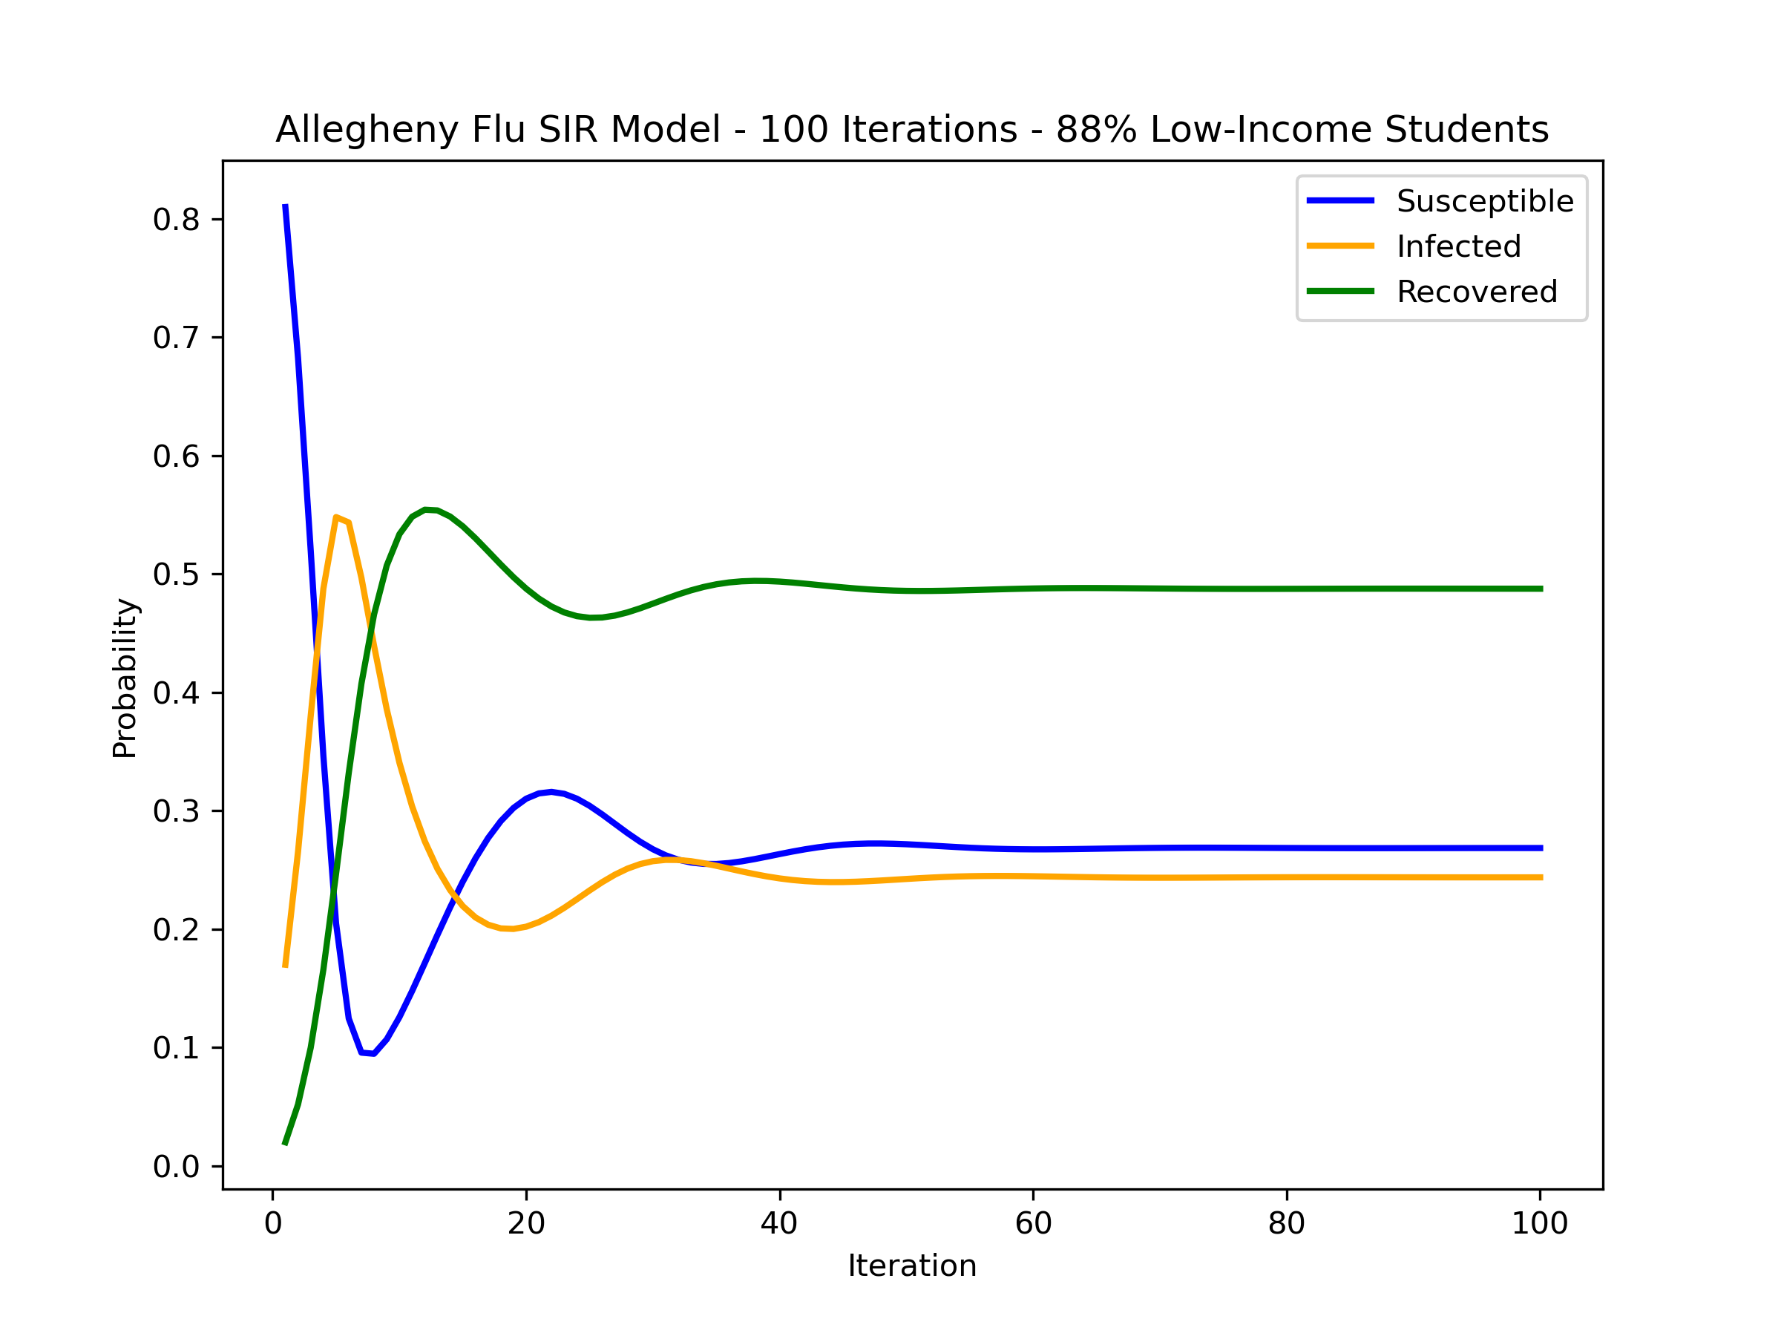
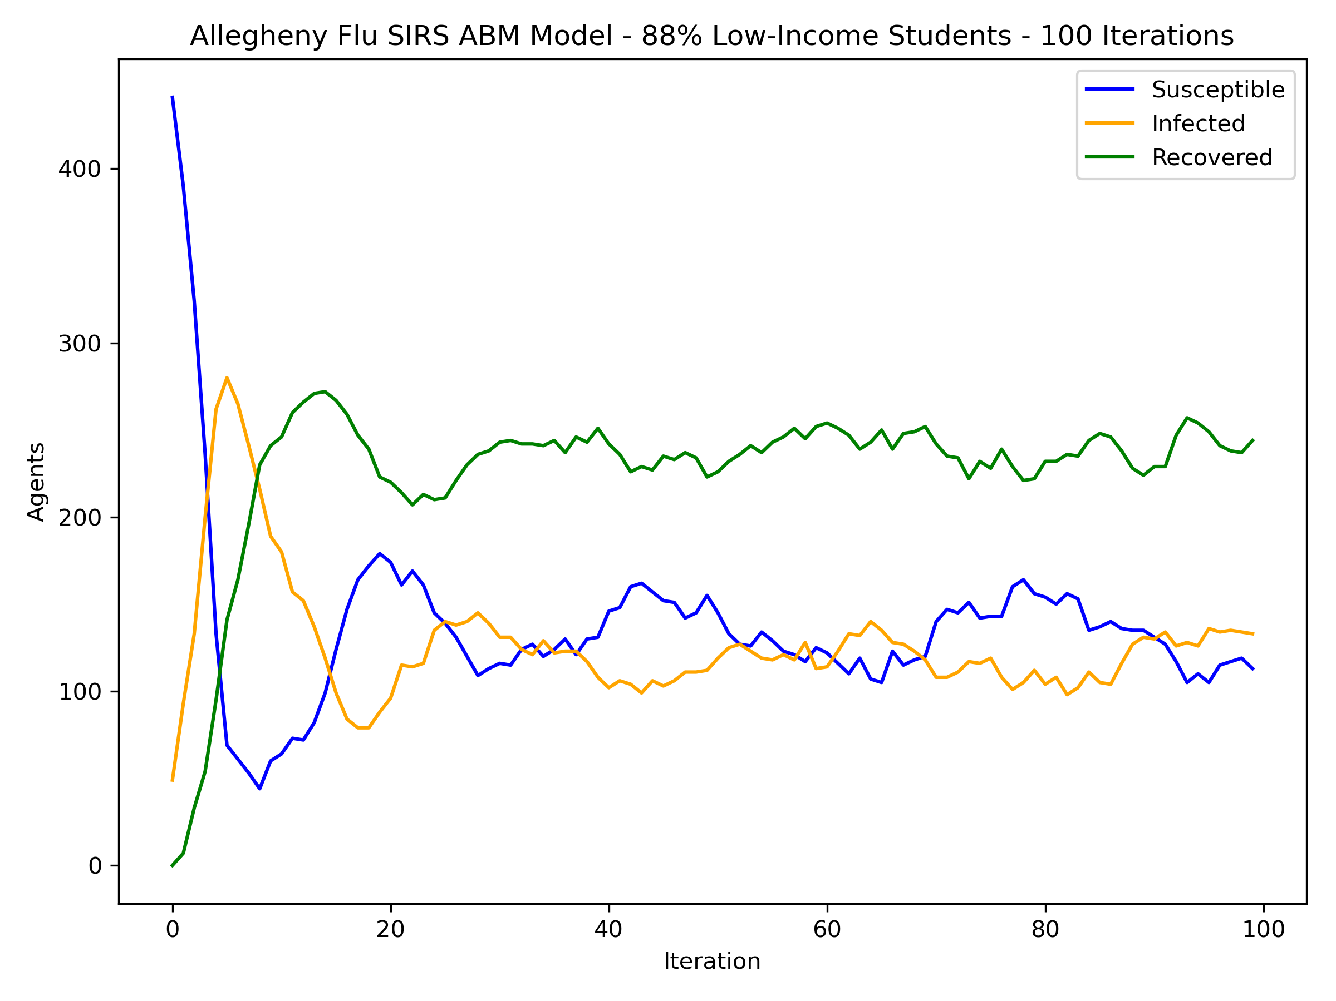
Allegheny Flu Model
This model is similar to the SIRS model from before, but uses a mock population of students from Allegheny County. The chance of getting infected is proportional to the number of sick students at your school. Students may stay home if sick, but low-income students are much less likely to.
Allegheny Flu Model in PRAM
Translated Allegheny Flu ABM
88% of students are low-income at this school.
Notes:
1) Like most models here, this is highly simplified (i.e. no weekends)
2) The ABM is run with only the two schools we are looking at, again for time concerns. This shouldn’t be an issue, since schools don’t really interact anyway
3) Due to an oversight on my part, the original ABM graphs shown here have been lost. The new ones available on the GitHub repository are equivalent, but of course not identical

Slide 24
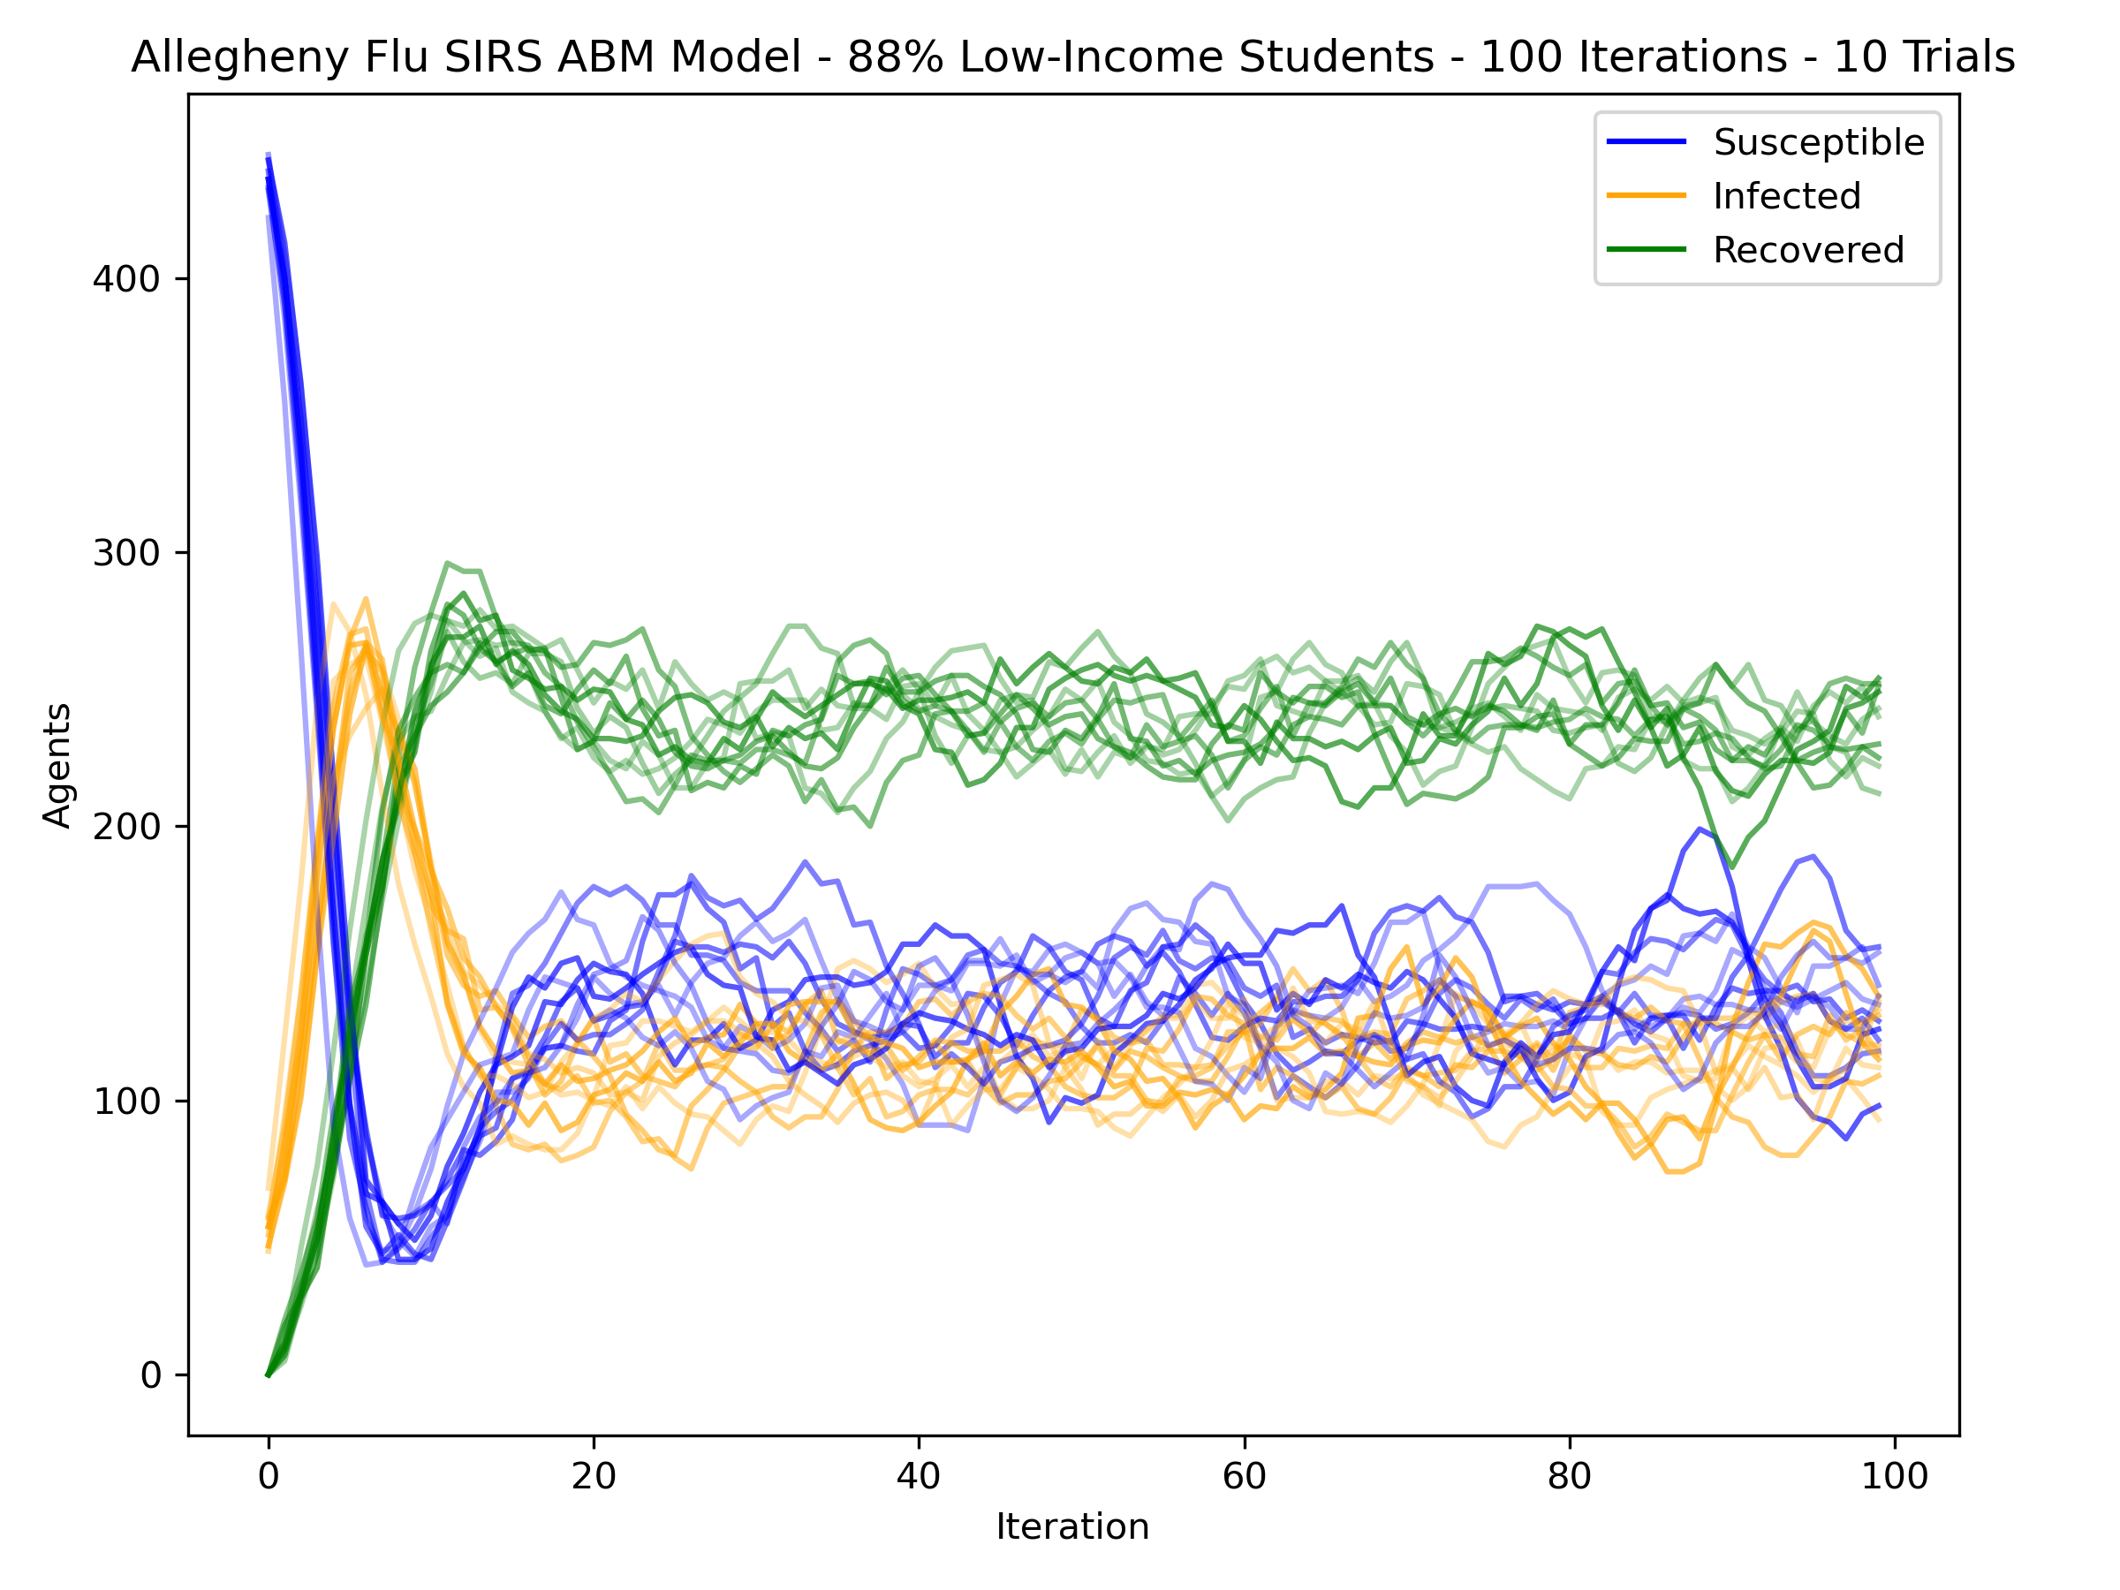
Allegheny Flu Model
This model is similar to the SIRS model from before, but uses a mock population of students from Allegheny County. The chance of getting infected is proportional to the number of sick students at your school. Students may stay home if sick, but low-income students are much less likely to.
Allegheny Flu Model in PRAM
Translated Allegheny Flu ABM
88% of students are low-income at this school.
(10 Trials)
Notes:
Like the original SIRS model, this stabilizes quickly. Because most students won’t go home, it is similar to the original SIRS

Slide 25
Allegheny Flu Model
This model is similar to the SIRS model from before, but uses a mock population of students from Allegheny County. The chance of getting infected is proportional to the number of sick students at your school. Students may stay home if sick, but low-income students are much less likely to.
Allegheny Flu Model in PRAM
Translated Allegheny Flu ABM
7% of students are low-income at this school.

Slide 26
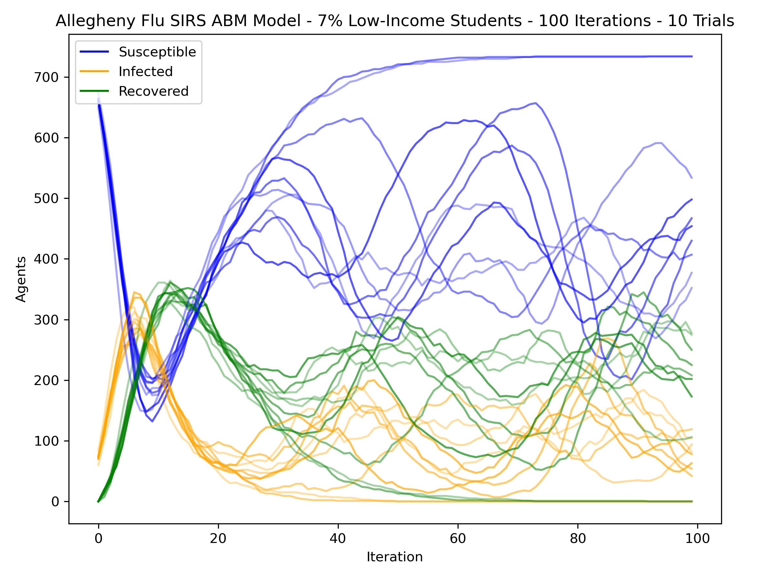
Allegheny Flu Model
This model is similar to the SIRS model from before, but uses a mock population of students from Allegheny County. The chance of getting infected is proportional to the number of sick students at your school. Students may stay home if sick, but low-income students are much less likely to.
Allegheny Flu Model in PRAM
Translated Allegheny Flu ABM
7% of students are low-income at this school.
(10 Trials)

Slide 27
What’s different here?
The only difference between the two schools is the number of students and their income levels
Because low-income students almost always stay at school when sick, the eventual outcomes of the low-income school don’t fluctuate as wildly
Because medium-income students stay home about as much as go to school when sick, there’s more room for randomness in the outcome
In two of the runs, we in fact see the virus get ‘unlucky’ and die out
Notes:
Look at the two runs where the blue susceptible lines plateau; this means every agent is susceptible (i.e. none are infected)

Slide 28
PRAM vs ABM
PRAM
ABM
Fast; good with large populations
“Averages out” randomness
Has a stricter grammar
Relies on having groups of agents that are equivalent
Slow, especially with large populations
Every agent’s decision is individual
Open-ended
Can handle unique agents and properties that take many possible values

Slide 29
How about SD models and ODEs?
Although the translation tools were not made, we can still contrast these frameworks with PRAM and ABM.
Both are more abstract
Good for looking at the bigger picture, bad with details
Usually have few variables, and few possible states for an ‘agent’
Generally, neither require coding experience, unlike ABM or PRAM
Notes:
In general, you sacrifice simplicity and speed for power and flexibility

Slide 30
Which framework should I use?
It depends – there is not one ‘right answer’.
Here are some pointers:
If the status of individual agents is very important
If agents’ statuses are important, but agents don’t need to be unique
To look at overall structure and movement in a system
For simple, purely mathematical structure, or as a part of a more complex model
ABM
PRAM
SD
ODE

Slide 31

Next Steps
I will be continuing work with my research mentors in the fall
pram2mesa will stay to the sideline until needed
Other translational tools will be developed if needed

Slide 32
Acknowledgements
Thank you to:
Drs. Paul Cohen and Tomek Loboda, for their mentorship this summer, and for creating PRAM
Dr. Brett Say, director of the Brackenridge Fellowship
The University of Pittsburgh Honors College, for funding the Fellowship
You, for taking interest in the project

Slide 33
Thank You!
Evan Kozierok
evan.kozierok@gmail.com

